Slide 1
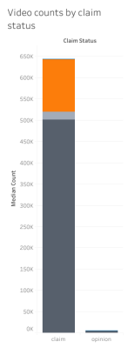
Predictive Model Development for Tik Tok Video Classification
EDA and preliminary data visualizations
Project Overview
The project aims to improve user engagement on TikTok by analyzing user behavior and predicting future trends.
Dataset includes 19,382 TikTok videos with various attributes.
Metrics show significant outliers, requiring robust statistical analysis.
Verified users less likely to post opinions.
Posters of claim videos more likely to face scrutiny.
'Video_view_count' could be a reliable predictor of claim status.
Claim videos significantly outperform opinion videos in terms of views.
Image Alt-Text Here
The next steps include refining the models, incorporating new variables into the analysis, and validating the models using real-world data. Adjustments will be made based on these validations.

